Slide 1
Real Time Face Identification and Tracking
Student - Prasoon Sharma Professor - Richard Green

Slide 2

Agenda
Introduction
Background
Solution
Results
Conclusion

Slide 3
Introduction
Face detection from continuous input from camera
Unknown face registration and storing of images in system
Training of model
Face identification from trained model

Slide 4
Background
prior research done by Ariel Yap and Priyesh Jain respectively done in 2017 and 2016
Limitation of the algorithm that it is registering only ten images of unknown user
Concern on the training of model with a high number of images

Slide 5
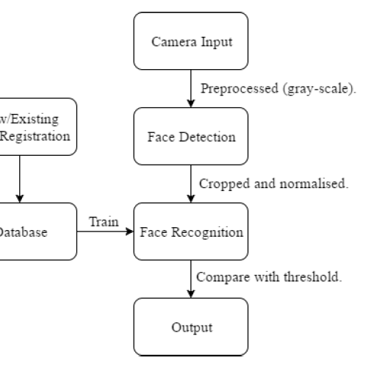
Solution
Face identification using Local Binary Pattern
Eyes identification using Haar cascade classifier
Training of the model using LBPH algorithm
Storing the thirty images of an unknown face in a folder named as ‘newface’

Slide 6
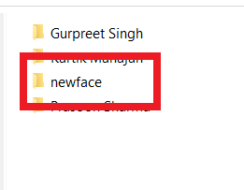
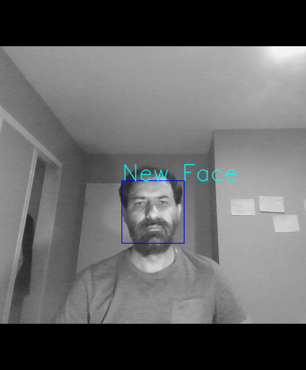
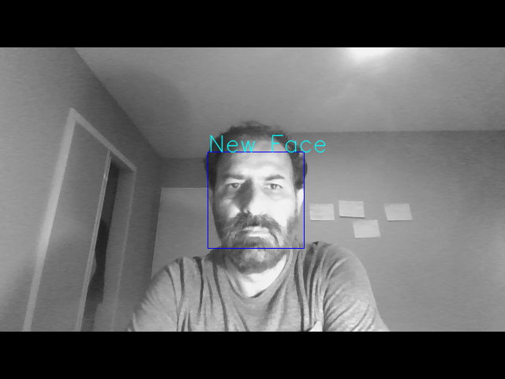
Results – unknown face

Slide 7
Results
The confidence level is around 90% on trained model
Less time in image storage and training of the model
Unknown face registration ~80-100mS, faster than prior research
Training of model with high number of images

Slide 8

Conclusion
Able to recognize face with the confidence level in between 55% to 87%
Time reduced in capturing of unknown faces
Expectation to training of model on GPU
Implementation of neural network

Slide 9

Thank You

